Slide 1

Batch
2
CSS
TYPOGRAPHY
The art of creating beautiful and easy to read text
By:
MWC
H-403

Slide 2
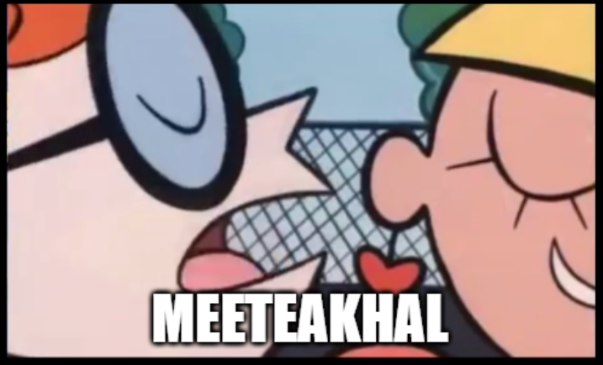
Mythical Website Coders

Slide 3
WHY TYPOGRAPHY
95% of the information on the web is written language. It is only logical to say that a web designer should get good training in the main discipline of shaping written information, in other words: Typography.
Notes:
Use to style font in italic
Italics normally slant slightly to the right.

Slide 4
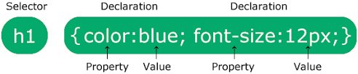
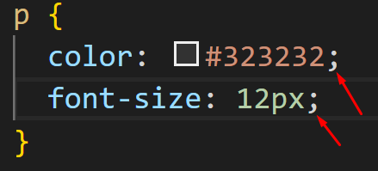
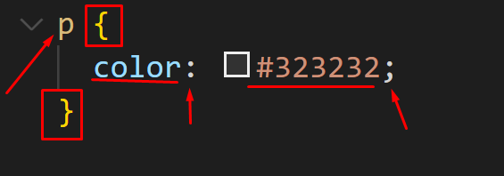
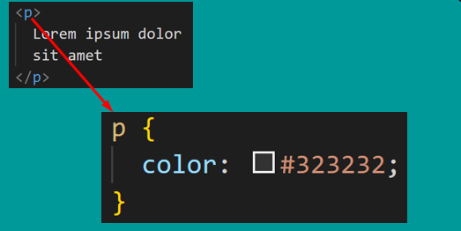
CSS syntax
Notes:
Use to style font in italic
Italics normally slant slightly to the right.

Slide 5
STYLING FONTS
font-family
font-weight
font-size
font-style
Notes:
Use to style font in italic
Italics normally slant slightly to the right.

Slide 6
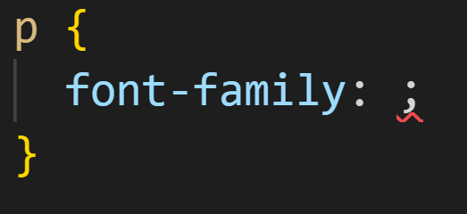
Font Family
Notes:
Use to style font in italic
Italics normally slant slightly to the right.

Slide 7
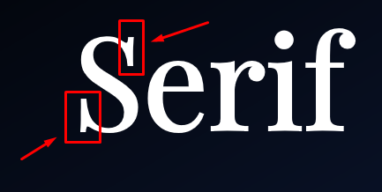
Categories of Font
Serif
Sans-serif
Georgia
Times New Roman
Arial
Helvetica
Futura
Notes:
But before that we will shortly discuss the 2 main categories of fonts
Of course there are more categories. But those categories are mostly used in printing, and they’re irrelevant for the web.
So what is the difference between these categories?
Well, serif fonts have a small line at the end of the characters . That’s why they are serious
They’re often used in books, newspapers and so on.
Georgia and Times New Roman are a couple of popular fonts in this category.
There are thousands of serif fonts out there. But these are the fonts that you hear about
Now, sans serif fonts don’t have those lines at the edge of characters
Here are a few popular fonts in this category
Arial, Helvetica, Futura and many more
They’re more playful and modern
-----------
So back to the font family property
Here is VS code if you press control + space VS code automatically suggest a bunch of fonts.
Called web safe fonts - they are called web safe fonts because they're available on most computers out there, so it's fairly safe to use them.
Let's type arial
We have here a font stack.
Font stack consists of multiple fonts, the first font here is arial.
So when the browser sees this, it will checks to see if this font is installed on the user's Computer.
If it is available, it's going to apply to the element you define. otherwise it's going to look at the next font in the stack.
once again the computer will check, if it is available the font is applied,
otherwise, the browser is going to look at the next font in the list or in the stack.
Now, the last font that we type here is a generic font, which can be either sans-serif or serif.
The actual font that will be used will vary from one computer to another. So we just type in generic name.
**********
Let's save the changes and see what we get.
Every computer have different
---------------

Slide 8
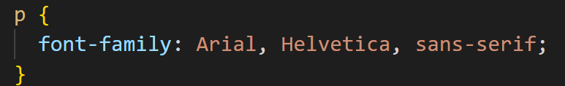
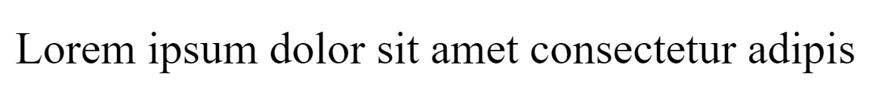
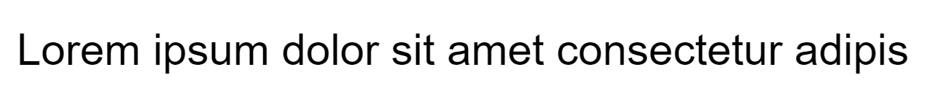
Font Family
FONT STACK
consist of multiple fonts as fallbacks
Notes:
Font stack consist of multiple fonts as fallbacks
The first font here is arial.
So when the browser sees this, it checks to see if this font is installed in the user's computer
If it is available it's going to apply to the element
Otherwise it's going to look at the next font in the stack,
in this case Helvetica , once again if this font is available, it's going to be applied otherwise, the browser is going to look at the end of stack which is serif a generic font, the font that will be used depends on default font on your operating system.

Slide 9
Font Family
FONT SERVICES
Google Fonts
Quick Video
Notes:
Font stack consist of multiple fonts as fallbacks
The first font here is arial.
So when the browser sees this, it checks to see if this font is installed in the user's computer
If it is available it's going to apply to the element
Otherwise it's going to look at the next font in the stack,
in this case Helvetica , once again if this font is available, it's going to be applied otherwise, the browser is going to look at the end of stack which is serif a generic font, the font that will be used depends on default font on your operating system.

Slide 10



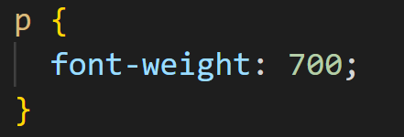






Font Weight
Weight Name | Value
Thin | 100
Extra Light | 200
Light | 300
Regular | 400 | default
Medium | 500
Semi Bold | 600
Bold | 700
Extra Bold | 800
Black | 900
Notes:
Sets the weight (or boldness) of the font.
The weights available depends on the font-family that is currently set

Slide 11
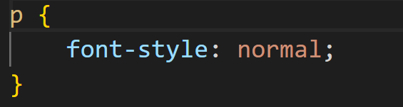
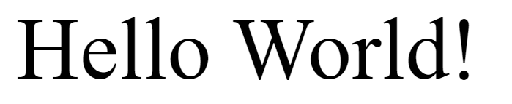
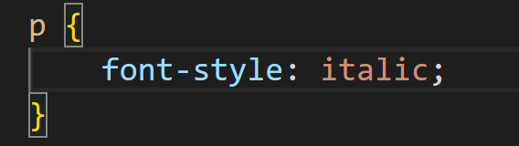
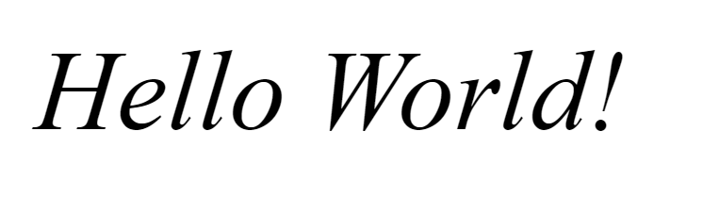
Font Style
default
Notes:
Use to style font in italic
Italics normally slant slightly to the right.

Slide 12
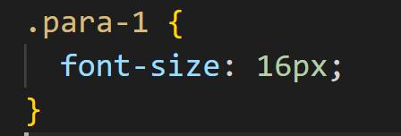
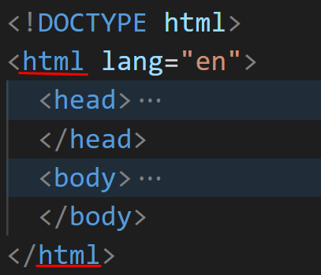
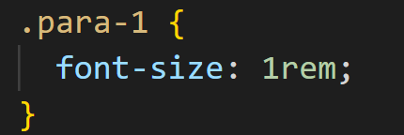
Font Size
Absolute value - fixed
Relative value
Relative to the font size of the root (html) element
Notes:
Use to increase or decrease the size of the fonts

Slide 13
Quick Video
Notes:
Use to increase or decrease the size of the fonts

Slide 14
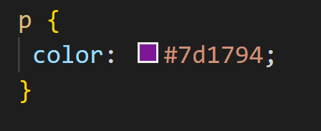
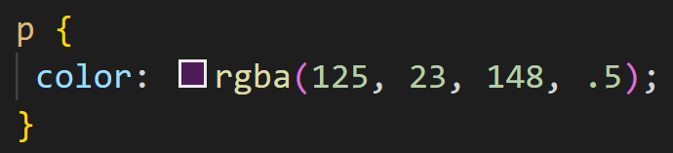
Color
hexadecimal
rgba
Supports transparency
Notes:
Use to set the color of text
Note: not text color just color

Slide 15
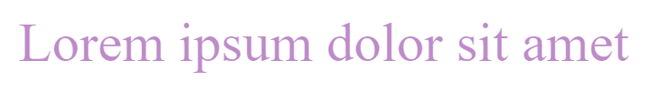
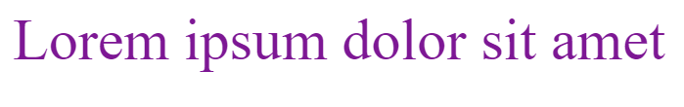
Color
Color picker
Color palette

Slide 16
Horizontal Spacing
max-width
Letter-spacing
Notes:
Going forward, we're going to talk about vertical spacing, or the vertical rhythm of our text.
We're gonna talk about two properties
line-height and margin

Slide 17
Length of Characters
Research has led to recommendations that line length should not exceed about 70 characters per line. The reason behind this finding is that both very short and very long lines slow down reading by interrupting the normal pattern of eye movements and movements throughout the text. (Nanavati, A.)
The ideal line length is about 60-70 characters.
Notes:
Use to increase or decrease the size of the fonts

Slide 18

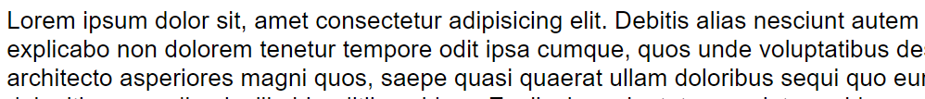

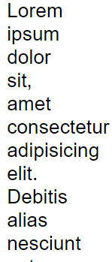

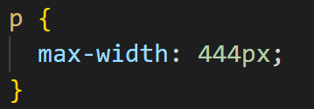
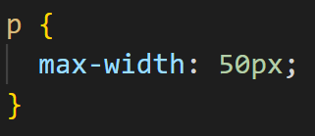
Max Width
The text is too narrow
Text expand across the browser

Slide 19
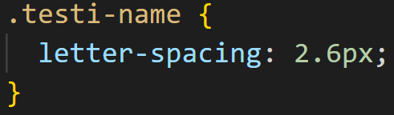


Letter Spacing
Text without letter spacing
Notes:
Sets the horizontal spacing behavior between text characters.

Slide 20
Vertical Spacing
line-height
margin
Notes:
Going forward, we're going to talk about vertical spacing, or the vertical rhythm of our text.
We're gonna talk about two properties
line-height and margin

Slide 21
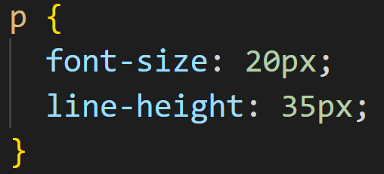
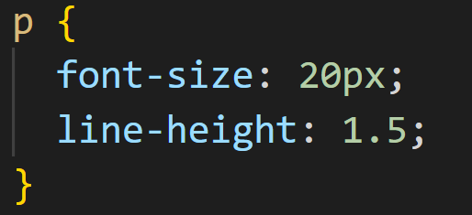
Line Height
need to change the line-height if you modify the font size
Unitless (recommended)
Notes:
set the line-height to specify the height of our lines
With this property we can adjust spacing between lines
We can bring the lines closer or farther

Slide 22
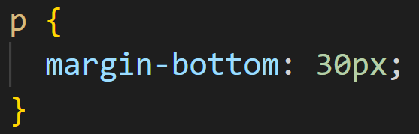


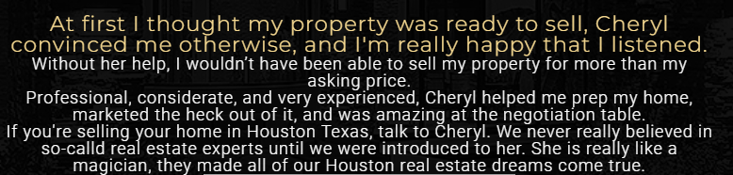
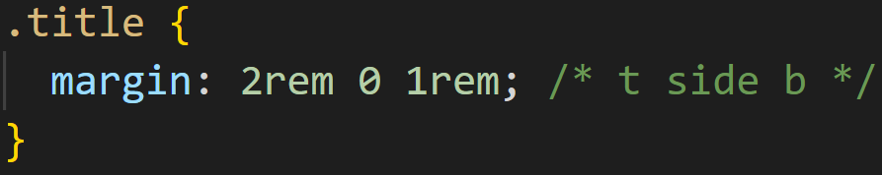
Margin
Notes:
Creates extra space around an element

Slide 23
Formatting Text
text-align
text-decoration
text-transform
white-space
Notes:
Going forward, we're going to talk about vertical spacing, or the vertical rhythm of our text.
We're gonna talk about two properties
line-height and margin

Slide 24
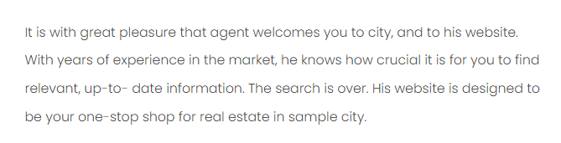
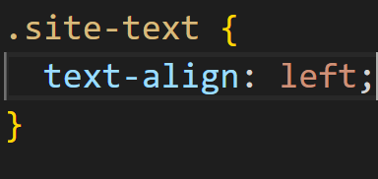
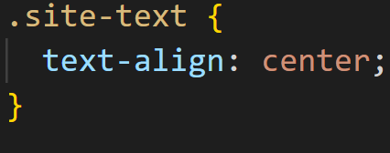
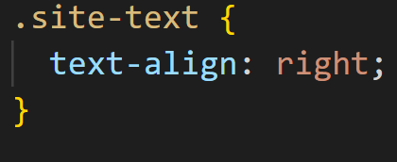



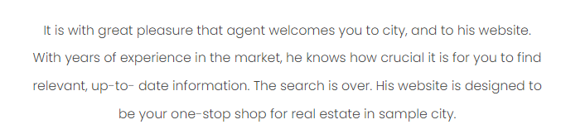
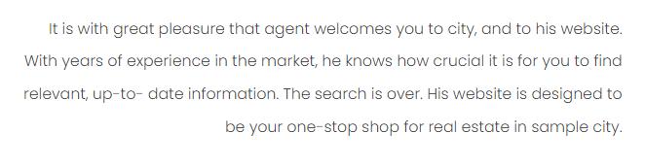
Text Align
default
Notes:
Change the alignment of text

Slide 25
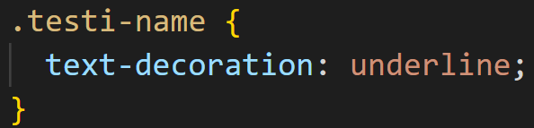
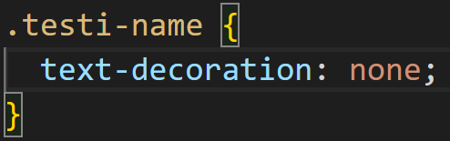


Text Decoration
Notes:
Control the wrapping of text

Slide 26
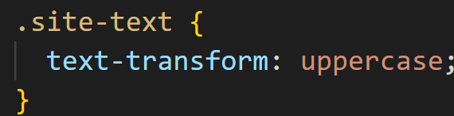
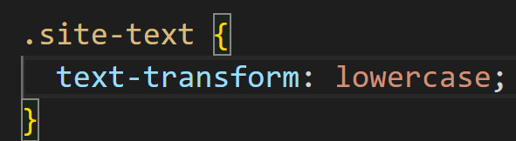


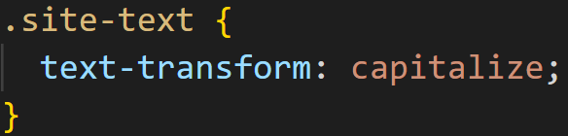
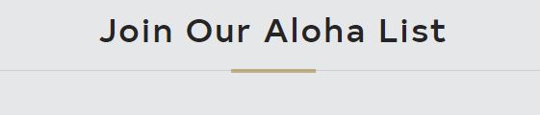
Text Transform
Notes:
Use to increase or decrease the size of the fonts

Slide 27
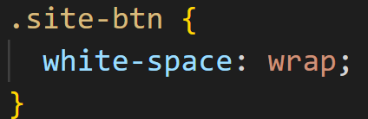
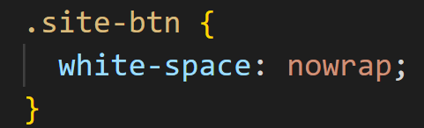


White Space
Smaller screen size
Notes:
Control the wrapping of text

Slide 28
Let’s see the final result
Notes:
Control the wrapping of text

Slide 29
Demo Video altogether

Slide 30
Reference:
https://eric.ed.gov/?id=EJ749012#:~:text=Research%20has%20led%20to%20recommendations,and%20movements%20throughout%20the%20text.
https://ia.net/topics/the-web-is-all-about-typography-period#:~:text=95%25%20of%20the%20information%20on,%2C%20in%20other%20words%3A%20Typography.

Slide 31
Thanks

